Slide 1

Lecture 8
Doubt’s Session

Slide 2
Java Scanner Class
import java.util.Scanner;
// read input from the input stream
Scanner sc1 = new Scanner(InputStream input);
// read input from files
Scanner sc2 = new Scanner(File file);
// read input from a string
Scanner sc3 = new Scanner(String str);

Slide 3
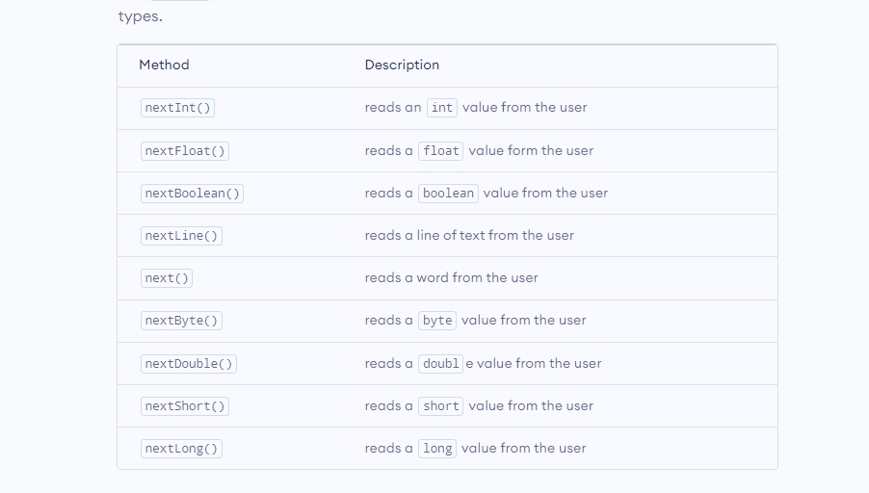
Java Scanner Methods to Take Input

Slide 4
NextInt()
import java.util.Scanner;
class Main {
public static void main(String[] args) {
// creates a Scanner object
Scanner input = new Scanner(System.in);
System.out.println("Enter an integer: ");
// reads an int value
int data1 = input.nextInt();
System.out.println("Using nextInt(): " + data1);
input.close();
}
}

Slide 5
Java Scanner nextDouble()
import java.util.Scanner;
class Main {
public static void main(String[] args) {
// creates an object of Scanner
Scanner input = new Scanner(System.in);
System.out.print("Enter Double value: ");
// reads the double value
double value = input.nextDouble();
System.out.println("Using nextDouble(): " + value);
input.close();
}
}

Slide 6
Java Scanner next()
import java.util.Scanner;
class Main {
public static void main(String[] args) {
// creates an object of Scanner
Scanner input = new Scanner(System.in);
System.out.print("Enter your name: ");
// reads the entire word
String value = input.next();
System.out.println("Using next(): " + value);
input.close();
}
}

Slide 7
Java Scanner nextLine()
import java.util.Scanner;
class Main {
public static void main(String[] args) {
// creates an object of Scanner
Scanner input = new Scanner(System.in);
System.out.print("Enter your name: ");
// reads the entire line
String value = input.nextLine();
System.out.println("Using nextLine(): " + value);
input.close();
}
}

Slide 8
Java Scanner with BigInteger and BigDecimal
nextBigInteger() - reads the big integer value from the user
nextBigDecimal() - reads the big decimal value from the user
import java.math.BigDecimal;
import java.math.BigInteger;
import java.util.Scanner;
class Main {
public static void main(String[] args) {
Scanner input = new Scanner(System.in);
System.out.print("Enter a big integer: ");
BigInteger value1 = input.nextBigInteger();
System.out.println("Using nextBigInteger(): " + value1);
System.out.print("Enter a big decimal: ");
BigDecimal value2 = input.nextBigDecimal();
System.out.println("Using nextBigDecimal(): " + value2);
}
}

Slide 9
Working of Java Scanner
The Scanner class reads an entire line and divides the line into tokens. Tokens are small elements that have some meaning to the Java compiler. For example,
Suppose there is an input string:
He is 22
In this case, the scanner object will read the entire line and divides the string into tokens: "He", "is" and "22". The object then iterates over each token and reads each token using its different methods.
Note: By default, whitespace is used to divide tokens.

Slide 10
System.out.print("Insert a number: ");
int number = input.nextInt();
input.nextLine(); // This line you have to add (It consumes the \n character)
System.out.print("Text1: ");
String text1 = input.nextLine();
System.out.print("Text2: ");
String text2 = input.nextLine();
when you are reading data from the console, it allows the user to type his response and when he is done he needs to somehow confirm that fact. To do so, the user is required to press "enter"/"return" key on the keyboard.

Slide 11
print Smallest number among three numbers using nested if else.
https://ide.geeksforgeeks.org/eea076fc-3a9c-4d14-990c-31061104a91c

Slide 12
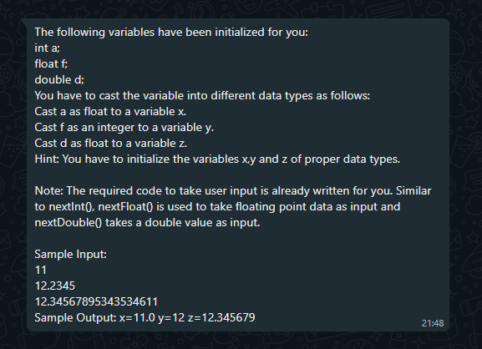

Slide 13
import java.io.*;
import java.util.*;
public class q {
public static void main (String[] args) {
Scanner sc=new Scanner(System.in);
int a=sc.nextInt();
float b=sc.nextFloat();
double c=sc.nextDouble();
System.out.println((float)a);
System.out.println((int)b);
System.out.println((float)b);
}
}

